Slide 1
Is Computer Science Major Still Hot?
Zhaohan Yan 172008944

Slide 2
Data Prepare
Sources: https://datausa.io/profile/cip/110701/
Format: .csv
Why study?
Computer Science Major are considered as hot major since majority of people believe comter science is the future development forcus and jobs in IT field have a big potential. However is it true that computer science market still hot? Let the data tell you.

Slide 3
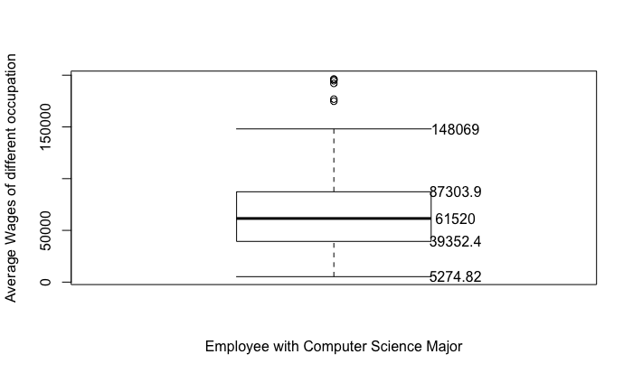
Differences in wages between Occupations
Use the boxplot function in R
We generate the following plot that gives us an idea of the distributions of wages between different Occupations in Computer Science Field.
We can see the wages differences are huge.

Slide 4
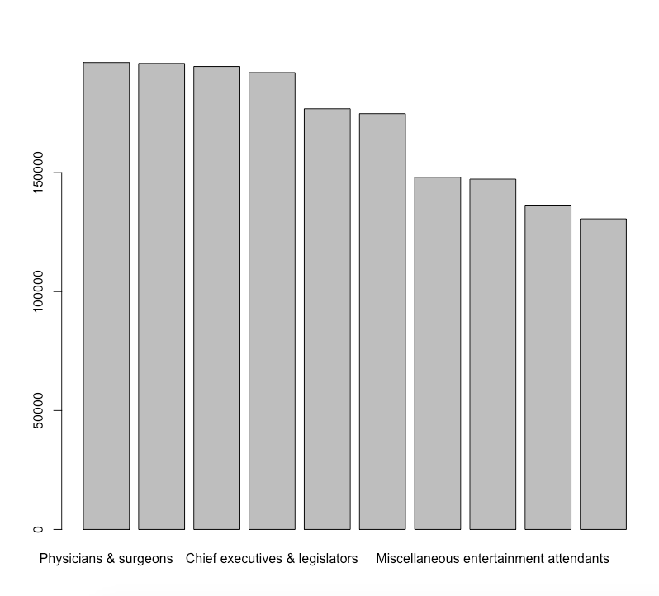
Know more about Different Occupations
Use barplot function we generate this bar chart contains the top 10 occupations with the highest wages.
Physicians & surgeons
Architectural & engineering managers
Securities, commodities, & financial services sales age
Chief executives & legislators
Lawyers, & judges, magistrates, & other judicial workers

Slide 5
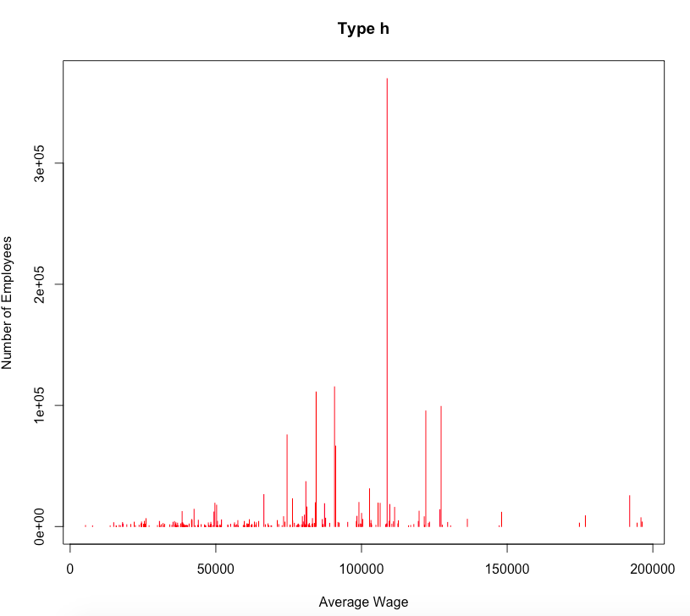
The relation between Wages and Number of Employees
Use the plot and line function we can plot a line graph between Average wages and number of employees in certain occupations.
The middle range in wages contains the most employees which is what we expected.

Slide 6
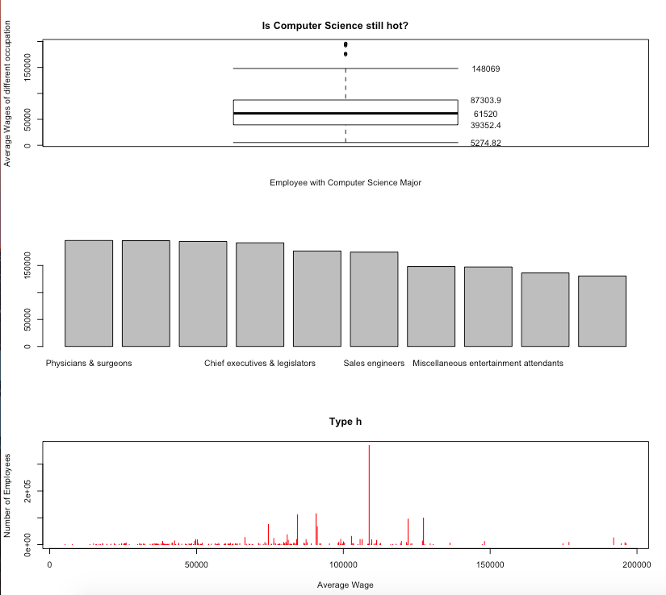
Data virtualization
Data Virtualization can help us generate a brief idea of what the dataset looks like which can help us with null hypothesis before going to real data analysis.
Sometimes data virtualization also give us a sense that weather this data is useful for our future research or analysis.
However, data need to be prepared before put in real use, we need to generate useful information from huge datasets.

